Slide 1
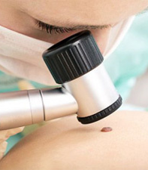
Analysis on HAM10000 dataset
Presented by:
Fadhil Salih

Slide 2
Outline
Abstract
Introduction
Methodology
Results
Conclusion
References

Slide 3

Abstract
HAM10000 is abbreviated as humans against machines with 10000 training dermatoscopic images
Each record is a dermatoscopic image of pigmented facial lesions collected from different populations
Each image, represented by 64 pixels (8X8), is classified into different labels
Each label represents an important diagnostic category in the realm of pigmented lesions
Aim: To perform supervised(Classification) and unsupervised (Clustering and Association) learning techniques on the HAM10000 dataset to produce useful information.

Slide 4
Introduction
Dermatoscopy is a widely used diagnostic technique that improves the diagnosis of benign and malignant pigmented skin lesions in comparison to examination with the unaided eye
Tschandl, Rosendahl, and Kittler (2015) researched on this dataset to better characterize dermatoscopic patterns of several types of flat pigmented facial lesions and to analyze their significance by calculating their relative risks and diagnostic values
They prospectively analyzed dermatoscopic images of 240 flat pigmented facial skin lesions collected consecutively from 195 patients (41.5% females, mean age: 61 ± 14 years) between 2007 and March 2012 in a primary skin cancer practice situated in Queensland, Australia.

Slide 5
Cont.
Cases include a representative collection of all important diagnostic categories in the realm of pigmented lesions such as:
Actinic keratoses and intraepithelial carcinoma / Bowen's disease (akiec)
Basal cell carcinoma (bcc)
Benign keratosis-like lesions (solar lentigines / seborrheic keratoses and lichen-planus like keratoses, bkl)
Dermatofibroma (df)
Melanocytic nevi (nv)
Vascular lesions (angiomas, angiokeratomas, pyogenic granulomas and hemorrhage, vasc)
Melanoma (mel)

Slide 6
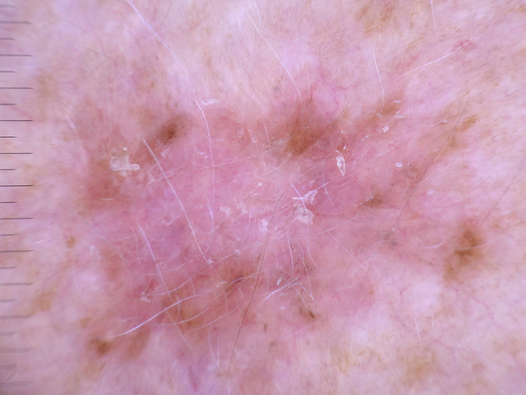
Label:0, akiec
Actinic keratoses and intraepithelial carcinoma / Bowen's disease

Slide 7
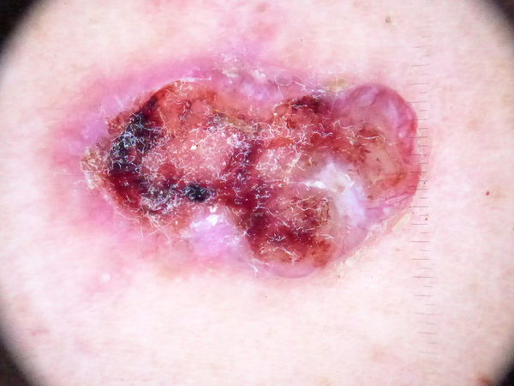
Label:1, bcc
Basal cell carcinoma

Slide 8
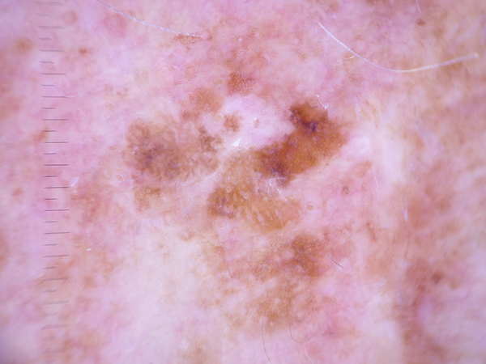
Label:2, bkl
Benign keratosis-like lesions (solar lentigines / seborrheic keratoses and lichen-planus like keratoses)

Slide 9
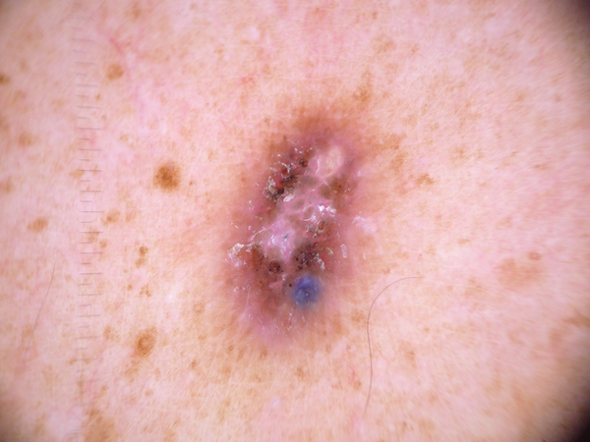
Label:3, df
Dermatofibroma

Slide 10
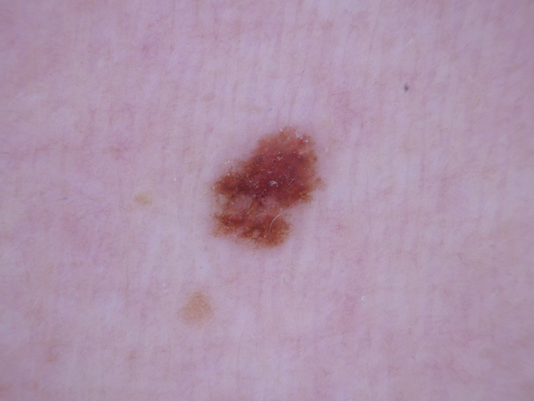
Label:4, nv
Melanocytic nevi

Slide 11
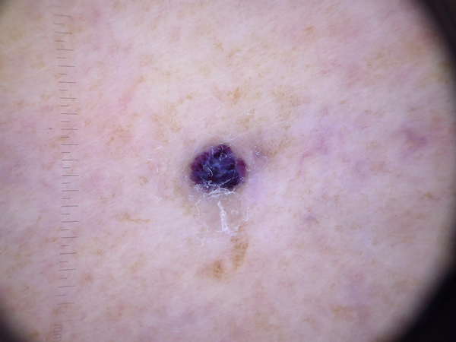
Label:5, vasc
Vascular lesions (angiomas, angiokeratomas, pyogenic granulomas and hemorrhage)

Slide 12
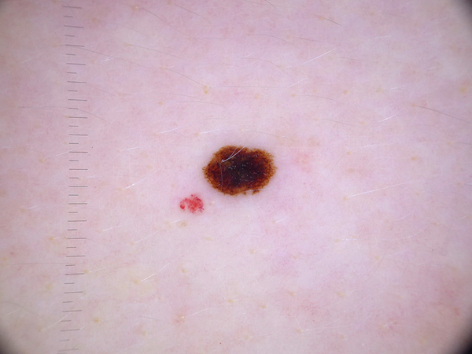
Label:6, mel
Melanoma

Slide 13
Methodology
Each record represents a dermatoscopic image of pigmented facial lesions, containing pixel information (8X8)
The target variable in this case is the label for supervised learning
The label represents the diagnostic category of the pigmented facial lesion
They are labelled from 0 to 6 respectively in the HAM10000 dataset
10015 dermatoscopic images were used for the study, out of which 7511 images were used to train and 2504 images were used to test the model using python
This was used for classification under supervised learning methods such as gaussian naïve bayes, support vector machines, random forest, decision tree, neural network(MLP), and k-nearest neighbor

Slide 14
Cont.
Clustering analysis was performed on the dataset in R, using k-means, fuzzy k-means, hierarchical clustering, nbclust and mclust
Association analysis was conducted on the entire dataset and between columns to produce useful information.

Slide 15
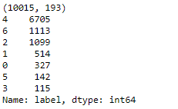
Results
Preliminary results indicate that most of the images have melanocytic neva followed by melanoma

Slide 16
Classification results
Classifiers such as gaussian naïve bayes and support vector machines, could only classify data that is not binarized
Since the dataset was not binarized, roc score for these classifiers are unavailable due to multi class error or bad input shape
Classifiers such as k-nearest neighbor, decision tree, random forest, neural network (MLP), classified a binarized dataset and produced useful results

Slide 17
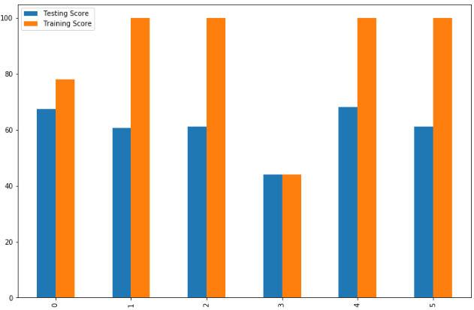
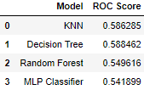
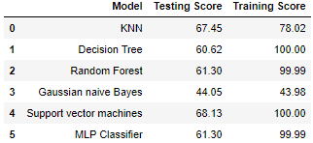
Cont.
We can see that support vector machines classifier has the highest accuracy in classifying the HAM10000 dataset

Slide 18
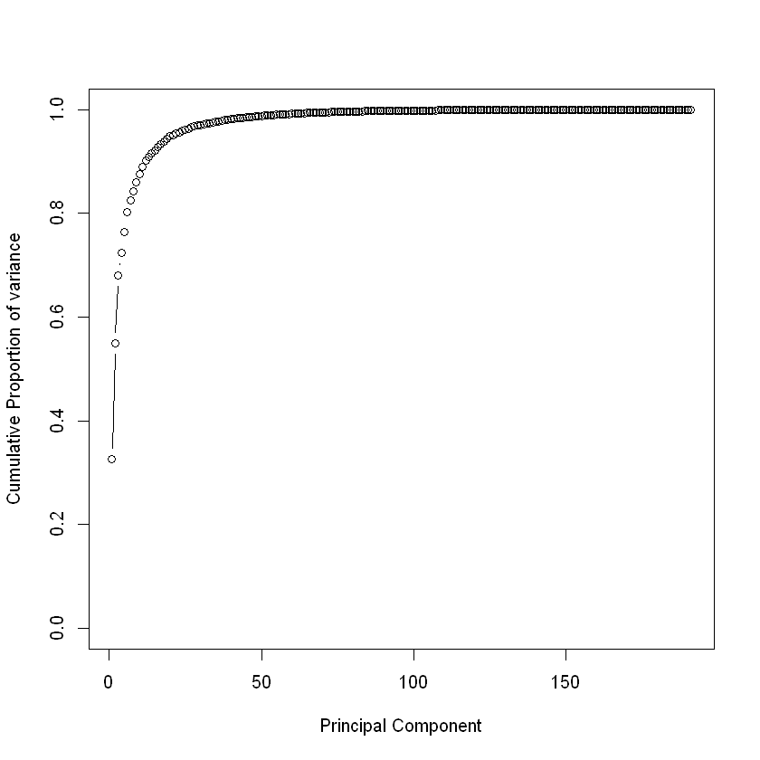
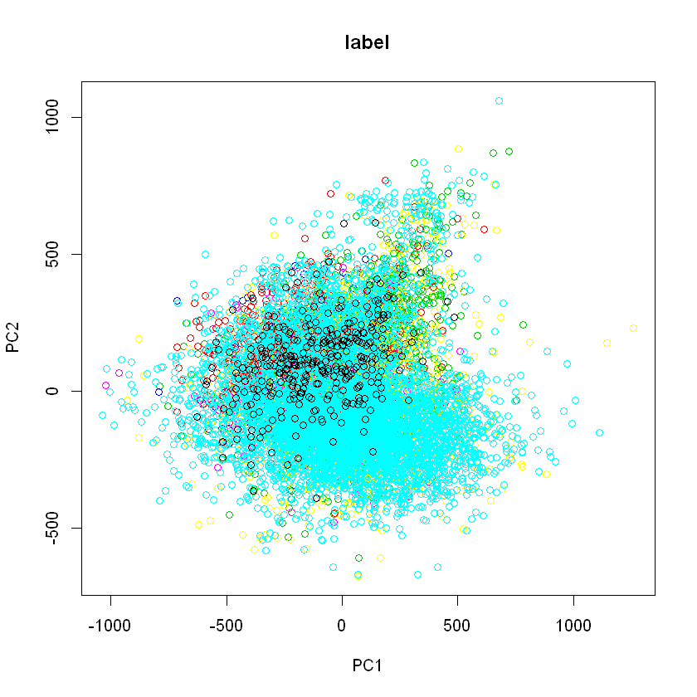
Preliminary clustering results
PCA:
It was seen that 20 PC’s retain 95% of the total variance, and 38 PC’s retain 98% of the total variance
I chose to analyze 20 PC’s

Slide 19
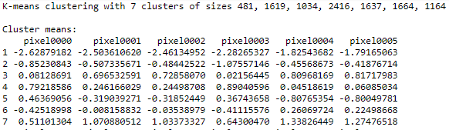
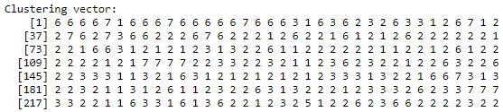
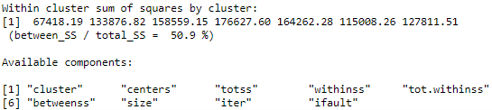
K-means
The reduction of sums of squares is 50.9% only
Hence, k-means clustering is not a good fit

Slide 20
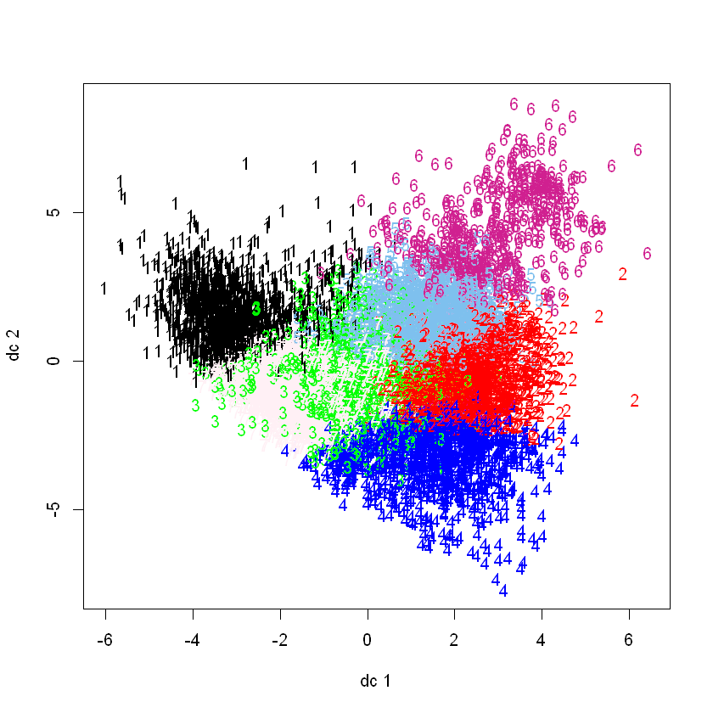
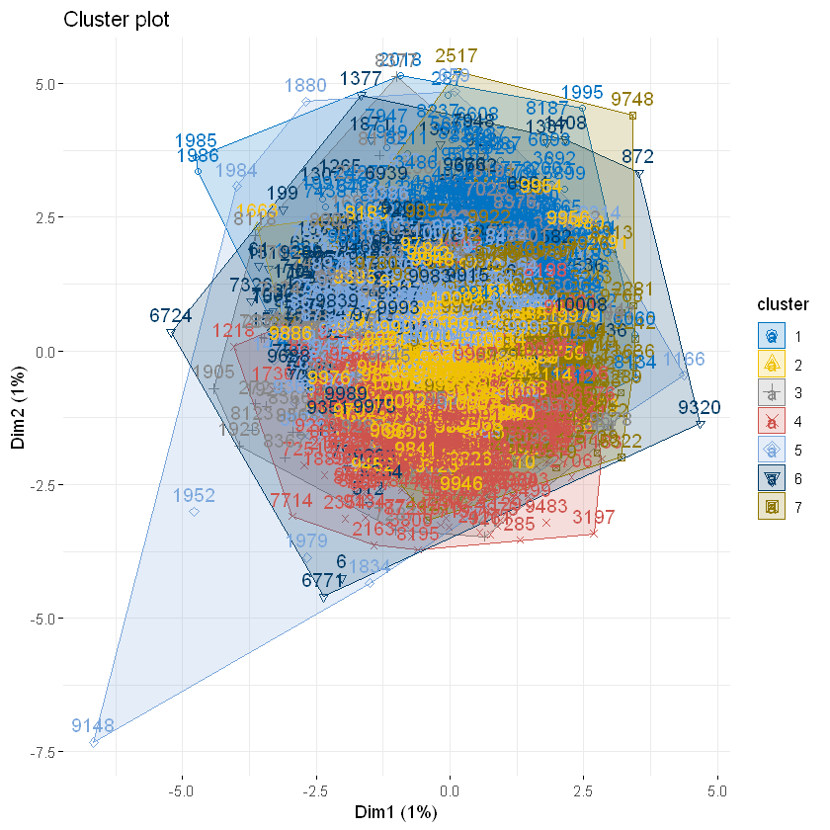
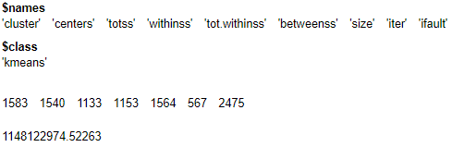
Fuzzy K-means
7 clusters were produced using the model
The objective function value is very high which is undesirable, as we need to minimize the intra-cluster variance

Slide 21
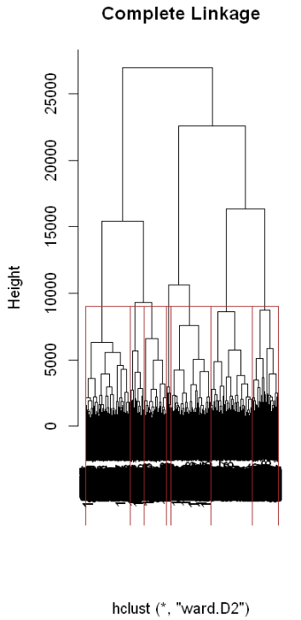
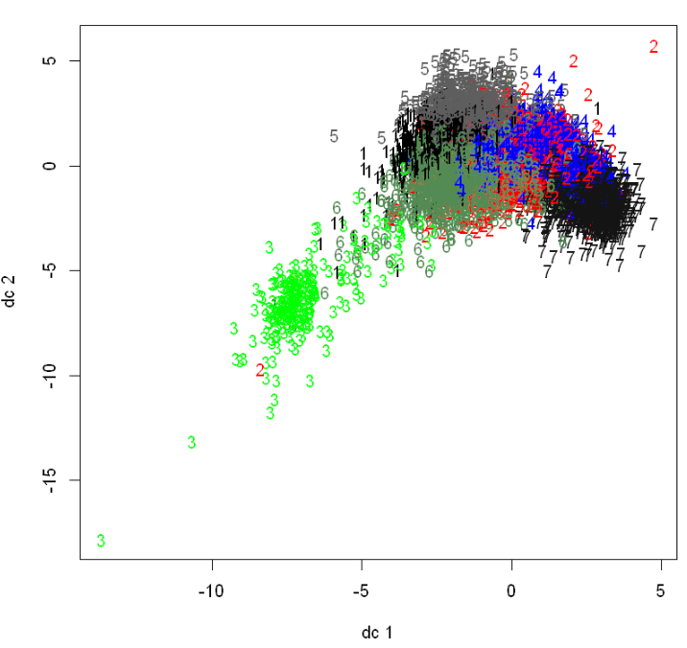
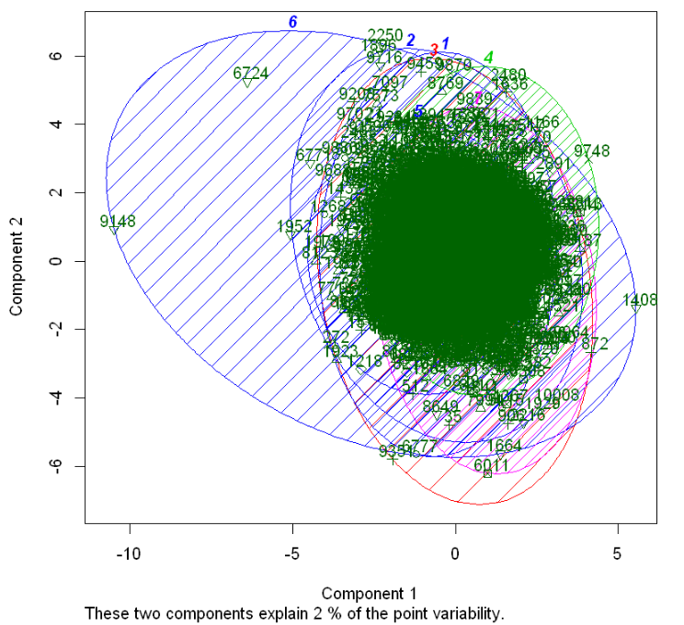
Hierarchical clustering
The results of hierarchal clustering indicates that the chosen number of clusters (k=7) are acceptable for analysis

Slide 22
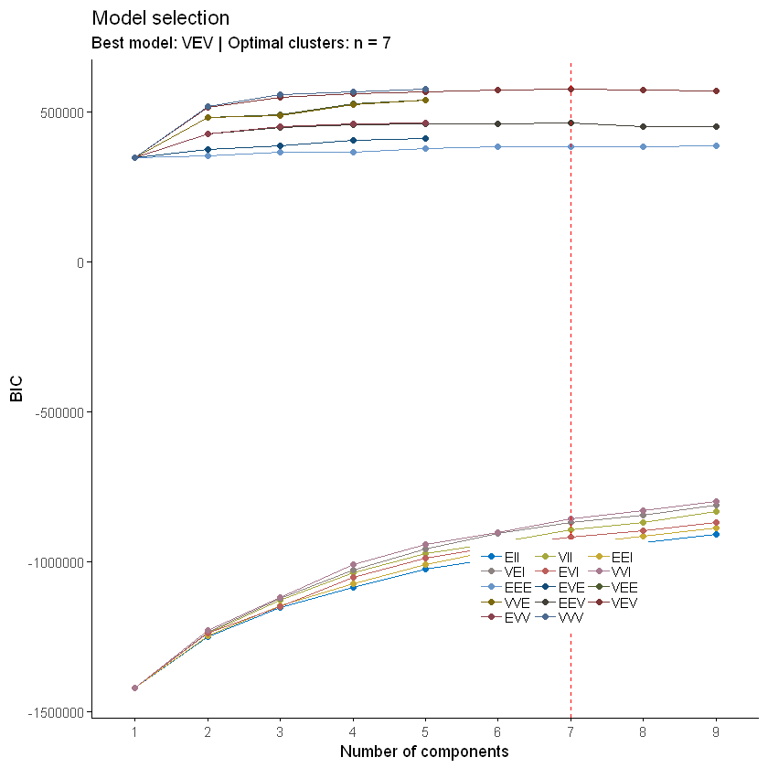
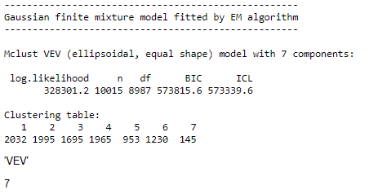
Model based clusters
MbClust results indicate that 7 is the optimal number of clusters using the VEV model, which is same as the number of required clusters which is 7.

Slide 23
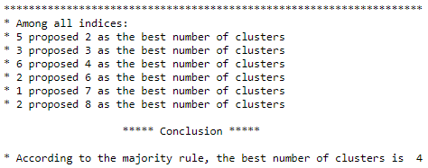
NbClust
Results indicated that 4 is the best number of clusters, according to majority rule
WSS, gap statistic and silhouette methods was executed to find the optimal number of clusters. Since the dataset is large, the code executed half way, without showing the results for WSS, gap statistic and silhouette method.

Slide 24
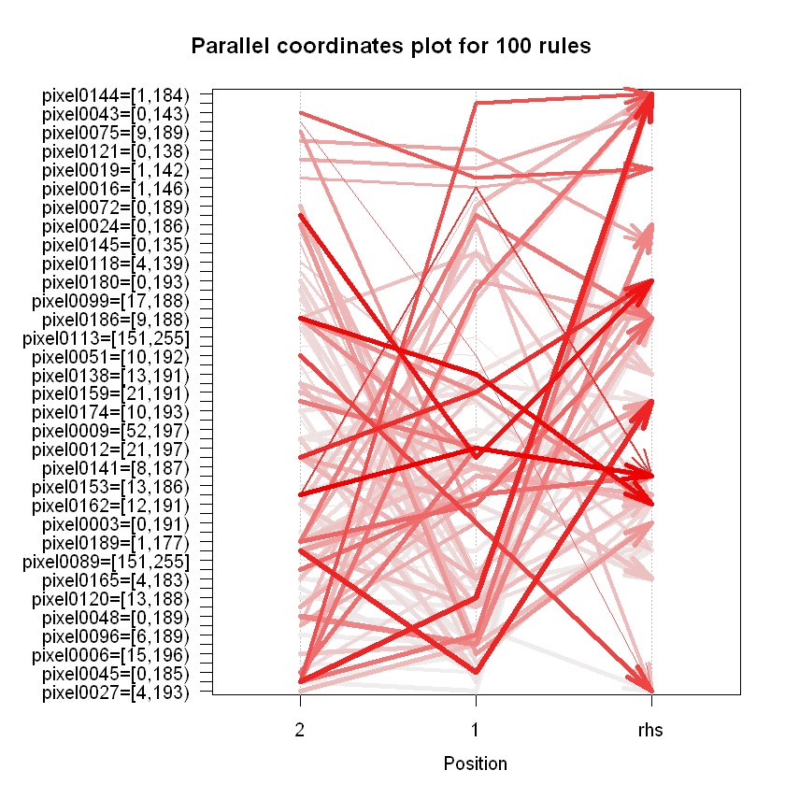
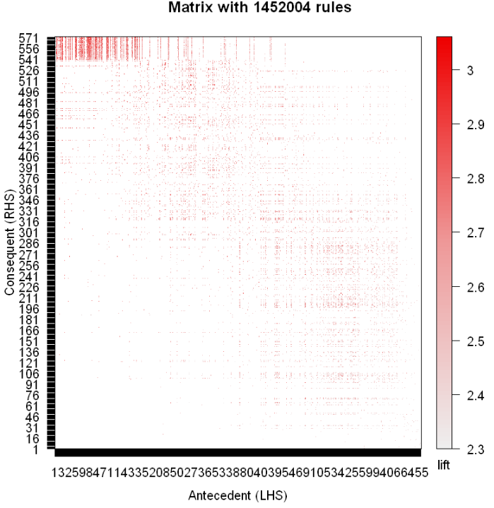
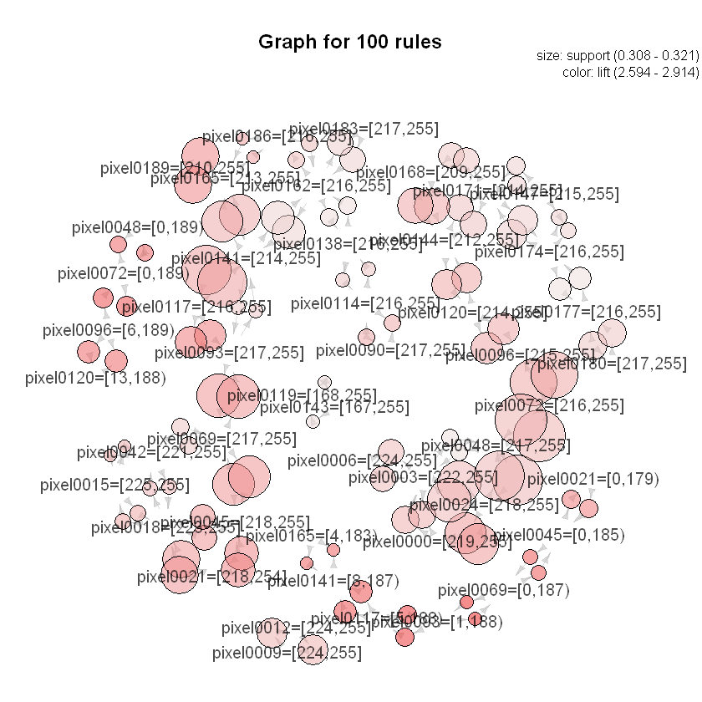
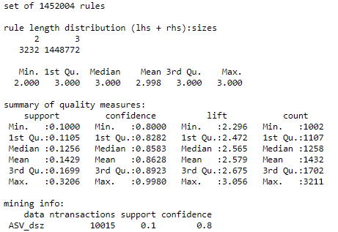
Association results
Association done on the entire dataset
A set of 1452004 rules were constructed
It essentially displays the relationship between vectorized pixel intensities

Slide 25
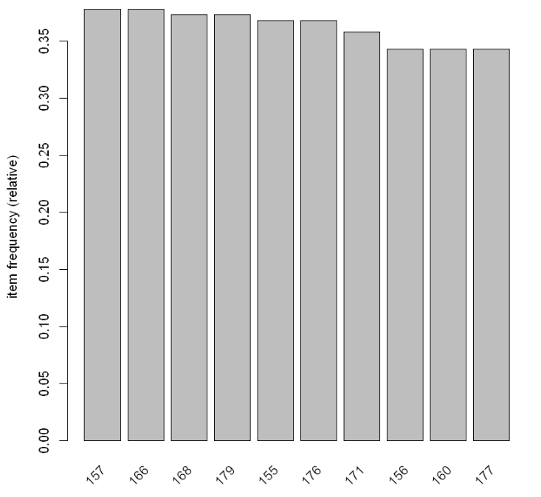
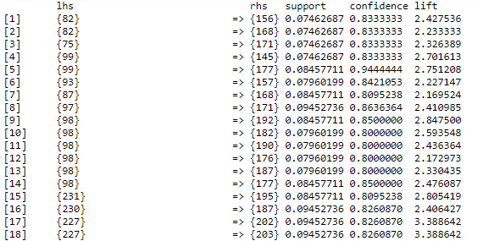
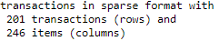
Cont.
Association done between pixel intensities in pixel0003 and pixel0081 (random 2 pixels)

Slide 26
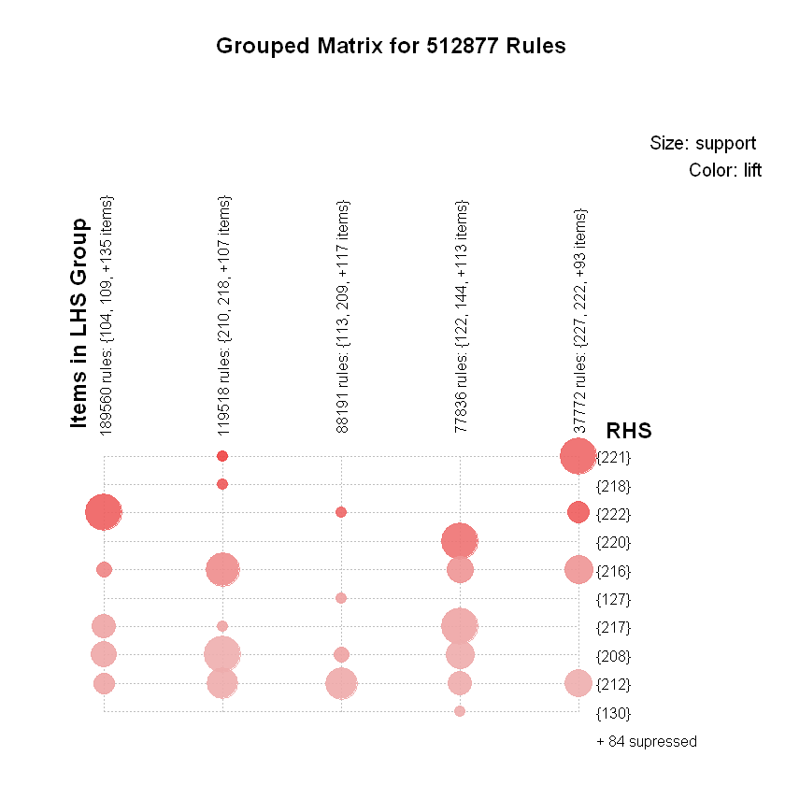
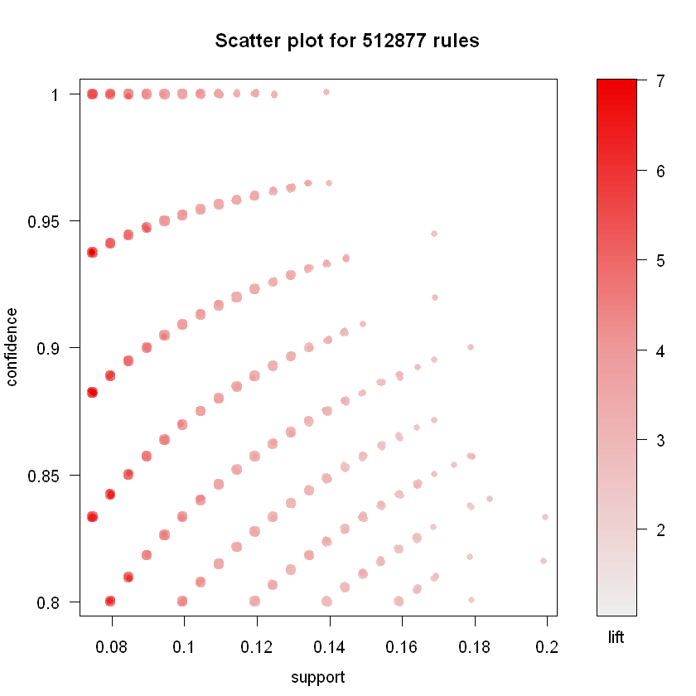
Cont

Slide 27
Conclusion
Classification results indicated that support vector machines classifier had the best accuracy for this dataset.
In terms of ROC curve, decision tree has the highest area under the roc curve
Clustering analysis revealed that the created clusters are somewhat acceptable for most models. Mbclust revealed that the optimal number of clusters is 7 which the required number of clusters.
Association reveals the relationship between different vectorized pixels in the dataset with significant confidence and support.

Slide 28
References
Tschandl, P., Rosendahl, C., & Kittler, H. (2015). The HAM10000 dataset, a large collection of multi-source dermatoscopic images of common pigmented skin lesions. Scientific Data. 5. http://dx.doi.org/10.1038/sdata.2018.161
https://www.kaggle.com/kmader/skin-cancer-mnist-ham10000/home

Slide 29
Thank you

